Slide 1
PROJECTIONS

Slide 2
Projections
Projections transform points from one 3 space to another 3 space
Viewing the results on a two dimentional surface requires a projection from 3 space to 2 space.
The result is called a Plane geometric projection.
Projection of objects are formed by the intersection of lines called projectors with a plane called the projection plane.
Projectors are lines from an arbitrary point called center of projection

Slide 3
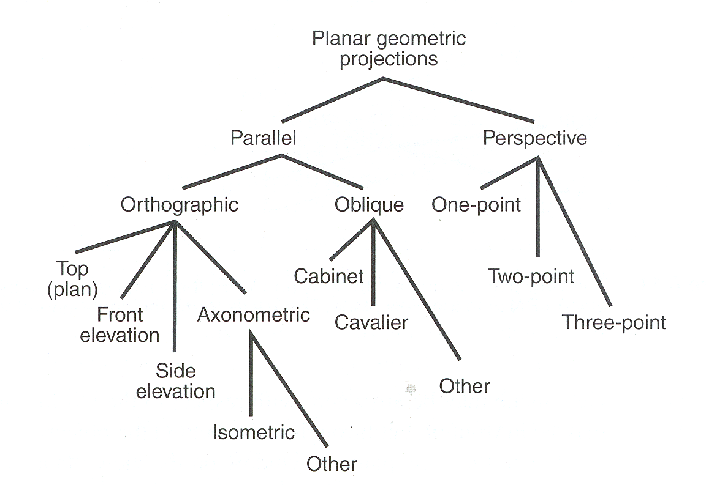

Slide 4
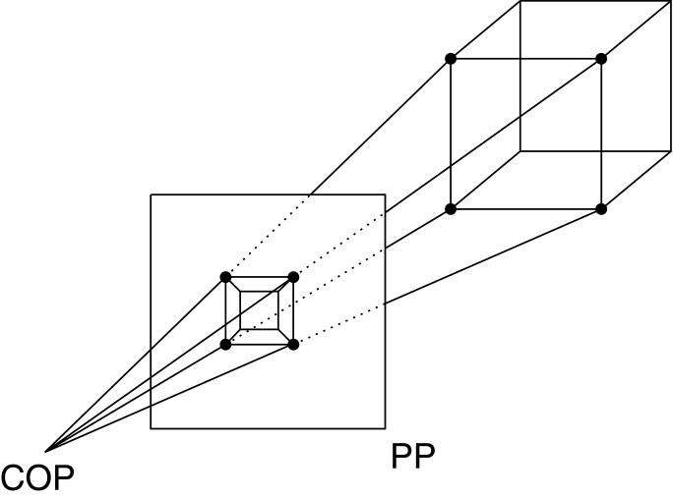
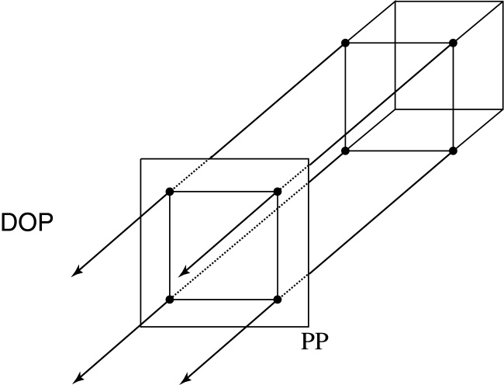
Plane Geometric Projection
There are two basic types of projections:
Perspective – distance from COP to PP finite
Parallel – distance from COP to PP infinite
Notes:
Scanalyze

Slide 5
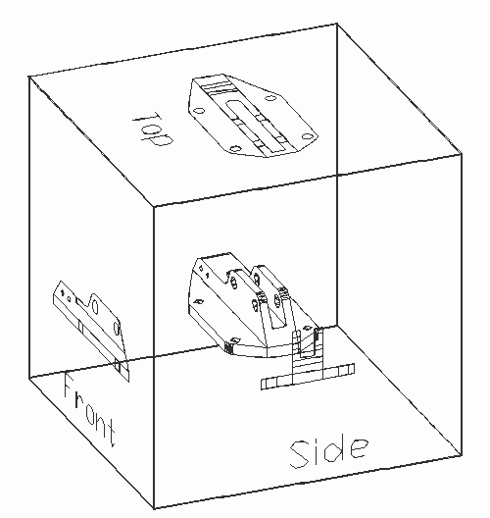
Properties of parallel projection
Properties of parallel projection:
Are actually a kind of affine transformation
Parallel lines remain parallel
Ratios are preserved
Angles not (in general) preserved
Not realistic looking
Good for exact measurements,
Most often used in
CAD,
architectural drawings,
etc.,
where taking exact measurement
is important
Notes:
Scanalyze

Slide 6
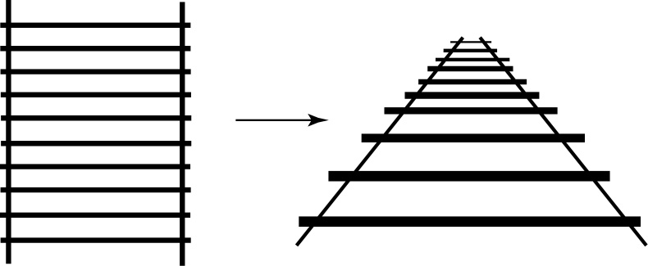
Properties of perspective projections
Here are some properties of projective transformations:
Lines map to lines
Parallel lines do not necessarily remain parallel
Ratios are not preserved
One of the advantages of perspective projection is that size varies inversely with distance – looks realistic.
A disadvantage is that we can't judge distances as exactly as we can with parallel projections.
Notes:
Stereo, occlusions, perspective (comparative size), focus, motion parallax
Auxiliary: sound

Slide 7
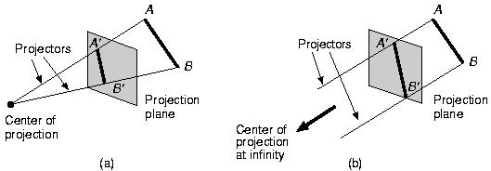
Projections
Parallel
Distance between projection plane and COP is infinite
Less realistic view
No foreshortening
Exact measurement and parallelism preserved
Perspective
Parallel

Slide 8
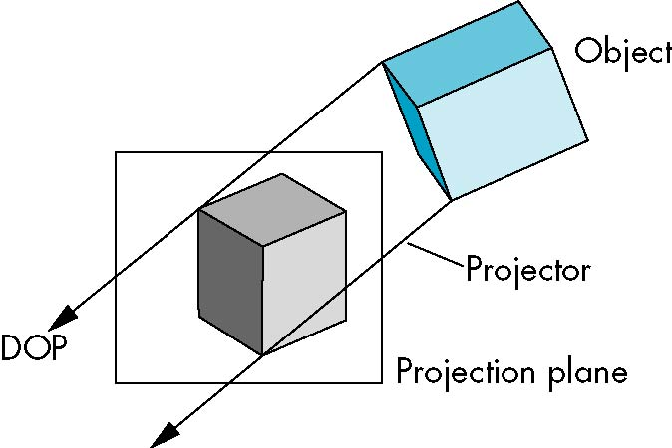
Parallel Projection

Slide 9
Parallel Projections
Two types, defined by
Direction of projection (DOP)
Viewing (projection) plane normal (VPN)
Orthographic :DOP and VPN the same (or the reverse)
Axonometric : Trimetric, dimetric ,isometric
Oblique :DOP of VPN not the same (nor the reverse)

Slide 10
ORTHOGRAPHIC PROJECTIONS
Used in engineering drawing (such as machine parts)
Projection plane perpendicular to a principle axis.
Hard to deduce 3D nature
Accurately show the correct size and shape of a single plane face of an object.
A single orthograpic projection does not provide sufficient information to visually and practically reconstruct the shape of an object.
Multiple orthograpic projections are necessary.
Most common types
Front-elevation (projection on z=0)
Top-elevation (plane-elevation) (projection on y=0)
Side-elevation(right ) (projection on x=0)

Slide 11
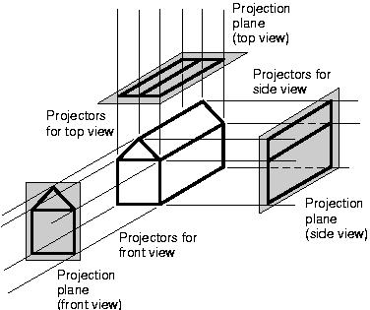
Orthographic Parallel Projections

Slide 12
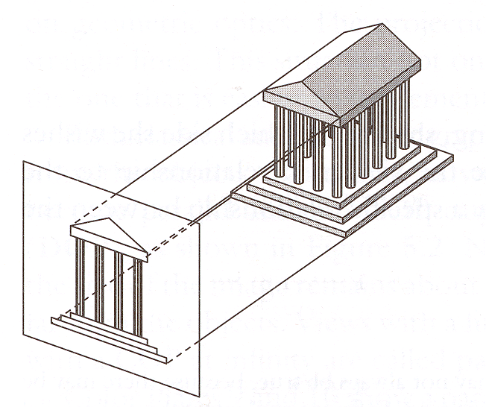
Parallel ORTHOGRAPHIC Projection
Center of projection is at infinity
Direction of projection (DOP) same for all points
View
Plane
DOP
Angel Figure 5.4

Slide 13
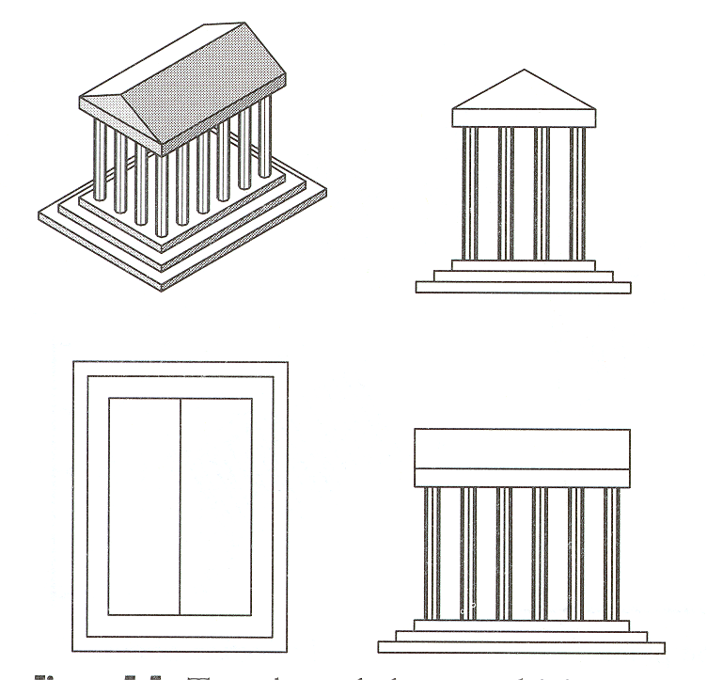
Orthographic Projections
DOP perpendicular to view plane
Front
Angel Figure 5.5
Top
Side

Slide 14
ORTHOGRAPHIC PROJECTIONS
Orthographic projections are projections onto one of the co-ordinate planes z=0 , x=0 or y=0.
The matrix for projection
|Pz|= |Px| = |Py| =
1 | 0 | 0 | 0
0 | 1 | 0 | 0
0 | 0 | 0 | 0
0 | 0 | 0 | 1
0 | 0 | 0 | 0
0 | 1 | 0 | 0
0 | 0 | 1 | 0
0 | 0 | 0 | 1
1 | 0 | 0 | 0
0 | 0 | 0 | 0
0 | 0 | 1 | 0
0 | 0 | 0 | 1

Slide 15
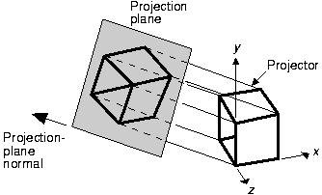
Axonometric Parallel Projections
Single orthographic projection fails to illustrate the general 3d shape of an object.
An axonometric projection is construceted by manipulating the object using rotation and translations such that at least three adjacent
The result is then projected from center of projection at infinity onto one of the co-ordinate planes usually z =0 lane.
Unless a face is parallel to the plane of projection , an axonometric projection do not show its true shape.
Relative length of originally parallel lines remain constant i.e parallel lines are equally foreshortened

Slide 16
Axonometric Projections
foreshortening factor
.
The foreshortening factor is the ratio of the projected length of a line to its true length.
There are three axonometric projections of interest
Trimetric
Dimetric
Isometric
Notes:
根据对立方体进行投影时一个角点处有多少个角相等进行分类

Slide 17
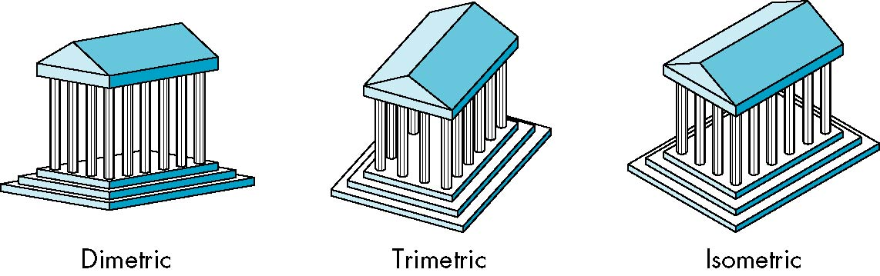
Types of Axonometric Projection
Trimetric : formed by arbitrary rotations in arbitrary order about any or all of the co-ordinate axes , followed by parallel projection onto the z=0 plane
The foreshortening ratios for each projected principal axis ( x ,y and z) are different in a general trimetric projection.
A principal axis is used in the sense of an axis or edge of the object originally parallel to one of the co-ordinate axis.
The foreshortening ratios are obtained by applying the concatenated transformation matrix to the unit vectors along the principal axis.
Xx* Yx* 0 1
Xy* Yy* 0 1
Xz Yz* 0 1
Fx = sqrt ( Xx*² + Yx*² )
Fy = sqrt ( Xy*² + Yy*² )
Fz = sqrt ( Xz*² + Yz*² )
1 0 0 1
0 1 0 1
0 0 1 1
U
T

Slide 18
Types of Axonometric Projection
DIMETRIC:
A dimetric projection is a trimetric projection with two of the foreshortening factors equal , the third is arbitrary.
A dimetric projection is constructed by a rotation about the y axis through an angle ф followed by a rotation about the x axis through an angle θ and projection at infinity onto the z = 0 plane.
The resulting transformation is
T = Ry . Rx . Pz

Slide 19
T | = | Ry | Rx | Pz
Cosф | 0 | -sin ф | 0
0 | 1 | 0 | 0
sinф | 0 | cosф | 0
0 | 0 | 0 | 1
1 | 0 | 0 | 0
0 | cosθ | sinθ | 0
0 | -sinθ | cosθ | 0
0 | 0 | 0 | 1
1 | 0 | 0 | 0
0 | 1 | 0 | 0
0 | 0 | 0 | 0
0 | 0 | 0 | 1
Cosф | Sin фsinθ | 0 | 0
0 | cosθ | 0 | 0
Sin ф | -Cosф sinθ | 0 | 0
0 | 0 | 0 | 1

Slide 20
The unit vectors on the x,y and z principal axis transformed to
U* = U . T =
1 | 0 | 0 | 1
0 | 1 | 0 | 1
0 | 0 | 1 | 1
Cosф | Sin фsinθ | 0 | 0
0 | cosθ | 0 | 0
Sin ф | -Cosф sinθ | 0 | 0
0 | 0 | 0 | 1
Cosф | Sin фsinθ | 0 | 1
0 | cosθ | 0 | 1
Sin ф | -Cosф sinθ | 0 | 1
U * =
The square of the length of the original unit vector along the x axis i.e the square of the foreshortening factor is now
Fx² = (Xx*² + Yx*² ) = cos ² ф+ sin ² ф sin ² θ ----------A
Fy ² = ( Xy*² + Yy*² ) = cos ² θ--------------------------------B
Fz² = ( Xz*² + Yz*² ) = sin ² ф+ cos ² ф sin ² θ --------C

Slide 21
1
Equating the foreshortening factors along the x and y principal axes
cos ² ф+ sin ² ф sin ² θ = cos ²θ
Since cos ² ф = 1- sin ² ф and cos ² θ = 1- sin ² θ ---D
sin ² ф = sin ² θ / 1- sin ² θ ---------------------------E
From equ. D and C
2 sin ² θ -2 sin ⁴ θ – (1 - sin ² θ) fx² = 0
2 sin ⁴ θ –(2+ fx² ) sin ² θ + fx² = 0
Letting u = sin ² θ yields
sin ² θ = fx² /2 , 1
Since sin ² θ = 1 yields an infinite result it is discarded
θ = sin ⁻¹ ( ± fx / sqrt2) and ф = sin ⁻¹ ( ± fx / sqrt(2- fx²))
Result shows that range of foreshortening factor is
0<= fx >=1 each foreshortening factor fx yields four possible dimetric projections.

Slide 22
Isometric : All three foreshortening factors are equal
From equ. E sin ² ф = sin ² θ / 1- sin ² θ
Equating equ. B and C sin ² ф = 1-2 sin ² θ / 1- sin ² θ s
From above equ. sin ² θ = 1/3 or sinθ = ± sqrt(1/3)
sin ² ф = (1/3) / (1- 1/3) = 1/2 and ф = ±45⁰
The foreshortening ratio of an isometric Projection is
fx = sqrt(cos ² θ) = sqrt(2/3) = 0.8165
An isometric projection is an special case of dimetric projection with
Fx = 0.8165
Transforming the unit vector along the x axis
U* = [1 0 0 1]
Cosф | Sin фsinθ | 0 | 1
0 | cosθ | 0 | 1
Sin ф | -Cosф sinθ | 0 | 1
Cosф | Sin фsinθ | 0 | 1
Cosф | Sin фsinθ | 0 | 1

Slide 23
Angle between projected x axis and the horizontal is then
Tan α = Yx* / Xx* = sinф / sinθ = ± sinθ
Since sinф = cos ф for ф= 45⁰
Alpha is then
α = tan -¹ ( ±sin 35.26439⁰ ) = ±30⁰

Slide 24
Advantages and Disadvantages
Lines are scaled (foreshortened) but can find scaling factors
Lines preserved but angles are not
Projection of a circle in a plane not parallel to the projection plane is an ellipse
Can see three principal faces of a box-like object
Some optical illusions possible
Parallel lines appear to diverge
Does not look real because far objects are scaled the same as near objects
Used in CAD applications

Slide 25
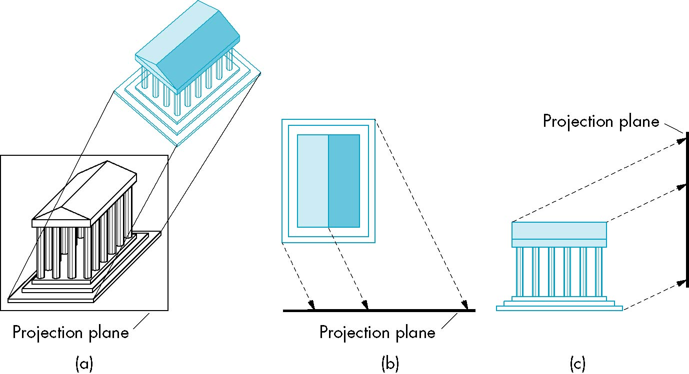
Oblique Projection
Arbitrary relationship between projectors and projection plane : projectors are perpendicular to the plane of projections from a center of projection at infinity that intersect the plane of projection at an oblique angle

Slide 26
Obliuqe Parallel Projections
Cavalier
DOP makes 45 degree with projection plane .
In cavalier projection the foreshortening factors for all the three principal directions are equal
Cabinet
DOP makes angle of cot ⁻¹ (1/2) = 63.43 with projection plane.
The foreshortening factor for edges perpendicular to the plane of projection is one half

Slide 27
Obliuqe Parallel Projections
Cavalier Cabinet
1
1/2
1
1

Slide 28
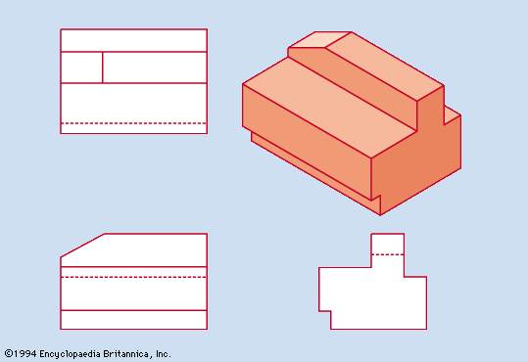

Advantages and Disadvantages
Can pick the angles to emphasize a particular face
Architecture: plan oblique, elevation oblique
Angles in faces parallel to projection plane are preserved while we can still see “around” side
In physical world, cannot create with simple camera; possible with bellows camera(波纹管相机) or special lens (architectural)

Slide 29
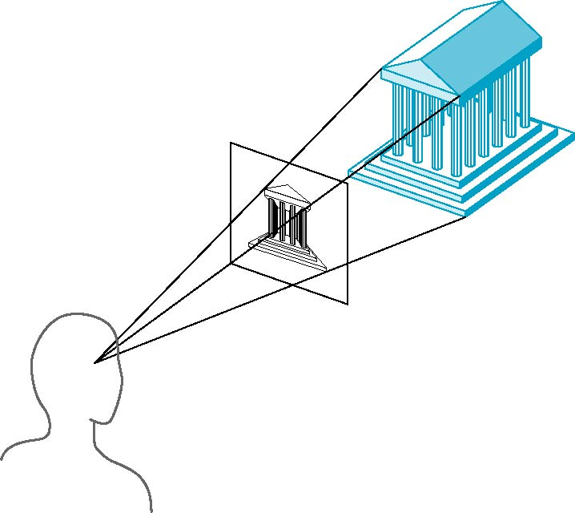
Perspective Projection
Projectors converge at center of projection
Naturally we see things in perspective
Objects appear smaller the farther away they are;
Rays from view point are not parallel.

Slide 30
Vanishing Points
vanishing point
Parallel lines (not parallel to the projection plan) on the object converge at a single point in the projection (the vanishing point)
Drawing simple perspectives by hand uses these vanishing point(s)

Slide 31
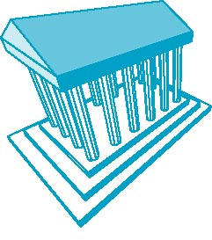
Three-Point Perspective
No principal face parallel to projection plane
Three vanishing points for cube

Slide 32
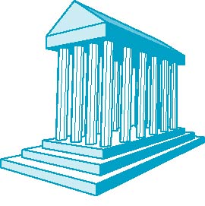
Two-Point Perspective
On principal direction parallel to projection plane
Two vanishing points for cube

Slide 33
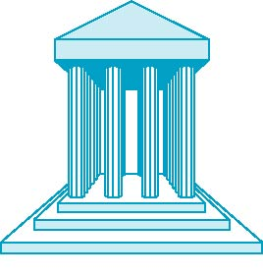
One-Point Perspective
One principal face parallel to projection plane
One vanishing point for cube

